Slide 1


WHO’S the Greatest of All time (GOAT)?
Michael Jordan vs. Kobe Bryant vs. Lebron James
BY:MONIQUE TOWNSON

Slide 2
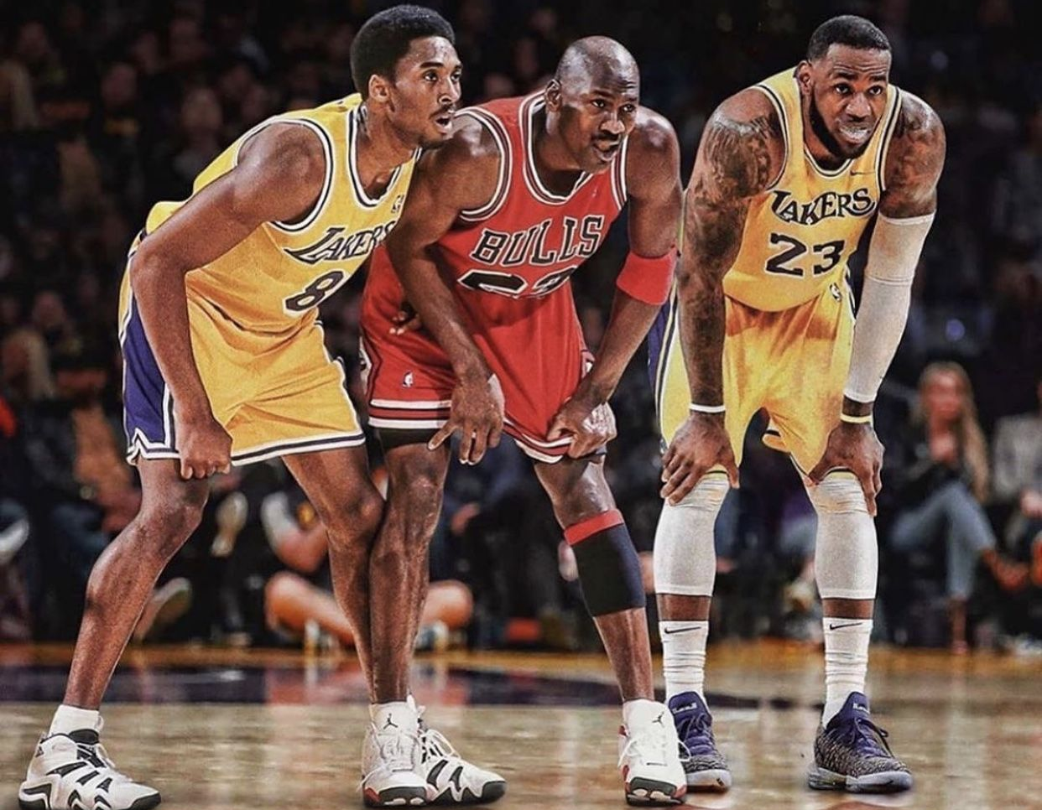
DATASETS
All Games Stats Dataset: Found on the Kaggle website
This dataset contains detailed per-game statistics spanning multiple seasons for each player. Key variables include field goals made and attempted, total points, assists, rebounds, steals, blocks, turnovers, and game outcomes (wins/losses). It provides a view of each player’s game-by-game performance and scoring efficiency.
Advanced Stats Dataset: Found on the Kaggle website
This dataset offers advanced performance metrics that capture a player’s overall impact and efficiency beyond traditional box score stats. Variables analyzed include true shooting percentage (TS%), usage rate, win shares, box plus-minus (BPM), and distribution patterns of points, rebounds, assists, steals, blocks, and turnovers
1984-1993 & 1995-2003 (15 seasons)
MICHAEL JORDAN
1996-2016 (20 seasons)
KOBE BRYANT
2003-present (22+ seasons)
LEBRON JAMES
Notes:
Before diving into the analysis, I want to highlight the sources of the data used in this project. The datasets were downloaded from the Kaggle website, a trusted platform for open data.
These datasets include detailed game-by-game statistics, covering key performance metrics like points, assists, rebounds, usage rate, shooting percentages, and more.
These data sets were used for all visualizations and statistical models in the project. For this project I aim to objectively compare each players individual and team impacts and ultimately explore the ever-popular question: Who is the greatest of all time?

Slide 3
Cleaning DATA
Removed any rows with missing or “0” games played
Filtered out unnecessary columns and double check formatting
Identify Missing data & Incomplete Rows
Notes:
Before tackling this question, I needed to make sure the data was accurate and relevant for comparing the greatest basketball players of all time. On this slide I will walk through how I cleaned and prepared the dataset.
First, I checked for missing values and incomplete data. Any rows with zero minutes played were removed.
Next, I filtered out columns that didn’t directly contribute to evaluating individual performance. Things like team name, league, or position. My goal was to focus on total production, not context-specific variables.
Finally, I made sure that all numeric data was formatted correctly, allowing for accurate calculations and visualizations later on. This step was key for building clean comparisons across players.
Overall, this process helped me refine the dataset into a format that truly reflects each player's on-court impact and sets the stage for fair and consistent analysis.

Slide 4
EVALUATION OF INFORMATION
To determine who is the greatest basketball player of all time, it’s essential to analyze a variety of key performance metrics that capture different aspects of their impact on the game. The selected variables provide a comprehensive view of each player’s offensive efficiency, scoring ability, playmaking, defensive contributions, and overall effectiveness:
Player | Points/ Game (PTS) | Field Goal Avg. (FG.) | Three Point Avg. (X3P.) | Total Rebounds (TRB) | Assist (AST) | Steals (STL) | Turnovers (TOV)
Kobe Bryant | 25.08 | 44.41% | 30.01% | 5.21 | 4.69 | 1.44 | 2.97
Lebron James | 27.44 | 50.33% | 30.95% | 7.66 | 7.20 | 1.64 | 3.50
Michael Jordan | 30.44 | 49.39% | 27.89% | 6.25 | 5.32 | 2.26 | 2.77
Kobe Bryant Trails slightly in efficiency and playmaking but remains a strong scorer. Can possibly show a high impact in other areas. | LeBron James Excels in shooting efficiency, rebounds, assists, and overall game impact, reflecting his all-around versatility | Michael Jordan Leads in scoring and steals, highlighting his offensive dominance and defensive impact
Notes:
Here I’m showcasing some of the key data I gathered as the foundation of my project. These statistics come from career averages of the players and they give us a high-level snapshot of each player's performance in core areas. The goal here isn’t to draw final conclusions just yet, but to highlight the kind of information I’ve found so far and what I want to dive deeper into.
For example, I noticed
LeBron stands out in rebounds and assists,
Jordan dominates in points and steals,
while Kobe maintains a strong all-around game.
These differences got me thinking: how do these stats translate to impact on team success? And how do metrics like usage rate or true shooting efficiency add context?
So, this table acts as a launch point helping me decide what areas to explore further to better understand each player’s impact and contribution toward their teams.

Slide 5

HOW TO Determine the Greatest Player?
Identifying Metrics to Analyze
Shooting Efficiency: Examined field goals made vs. attempted and true shooting percentage to assess scoring efficiency.
Overall Contribution: Compared total points, assists, rebounds, steals, blocks, and turnovers to understand each player’s all-around impact.
Advanced Metrics: Used win shares and box plus-minus to quantify each player's contribution to team success and overall value.
Usage and Distribution: Analyzed usage rates and the distribution of key stats to understand how players influence the game and their roles within their teams.
Win/Loss Impact: Investigated game outcomes to evaluate the players’ impact on team success.
Notes:
This marks the starting point of my analysis figuring out how to define ‘greatness’ in basketball. It’s not just about points or championships. To truly compare legendary players, I need to identify which metrics actually matter.
I broke this into two categories: Player Impact and Team Impact.
Player Impact includes stats like points, rebounds, assists, steals, blocks, turnovers, field goal percentage, and efficiency rating these show how much a player contributes in every aspect of the game.
Then, I considered Team Impact: things like win shares, usage rate, true shooting percentage, and overall win/loss records. These tell us how much a player’s performance translates into actual success for their team.
In short, this slide is about setting the foundation deciding what to analyze in order to make a fair and balanced comparison between some of the greatest to ever play the game.

Slide 6
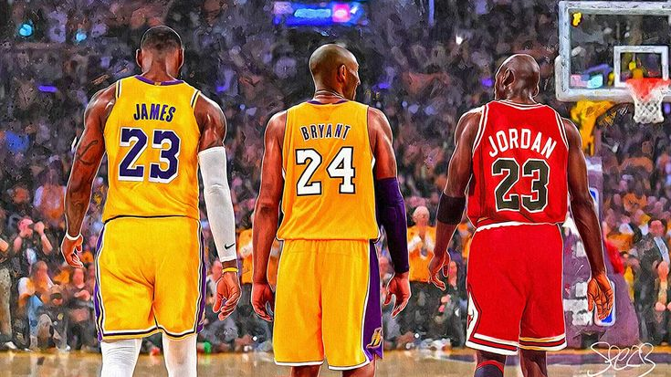
PLAYER IMPACT
OFFENSIVE IMPACT
DEFENSIVE IMPACT
FIELD GOALS (FG)
PLAYER EFFICIENCY RATING (PER)

Slide 7
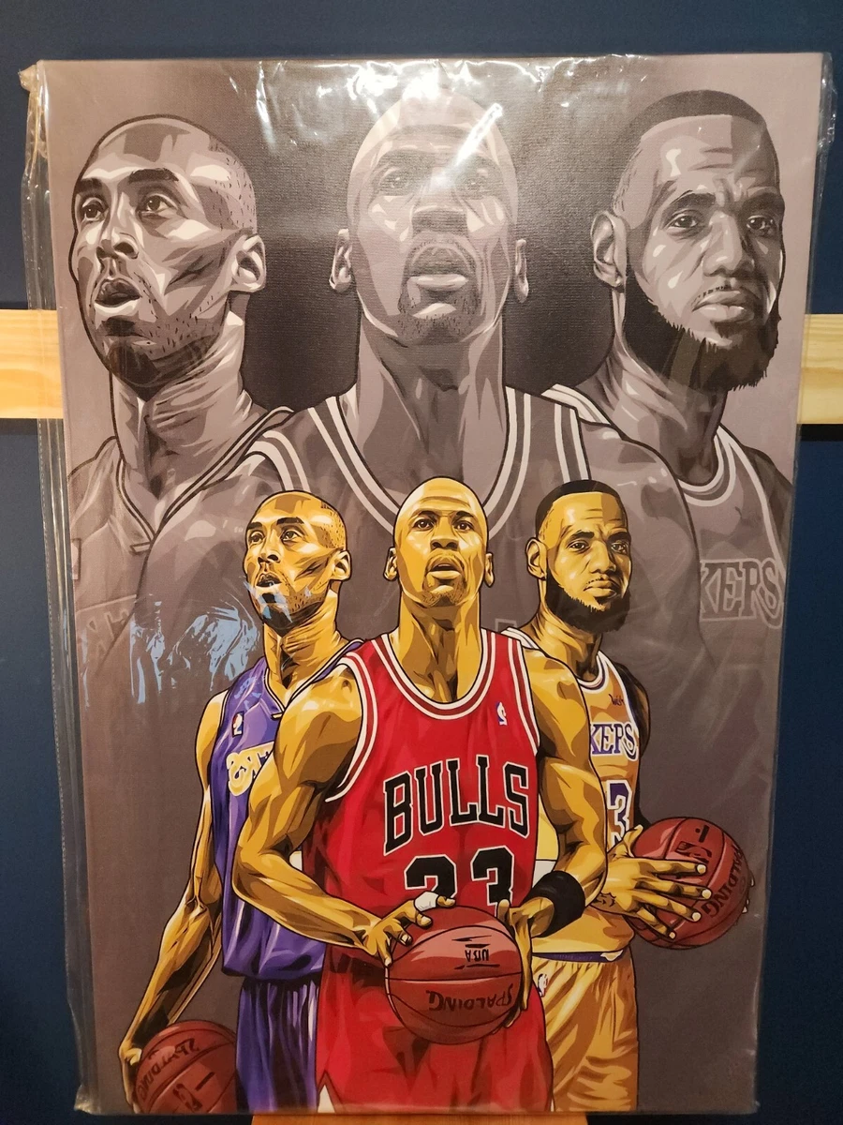
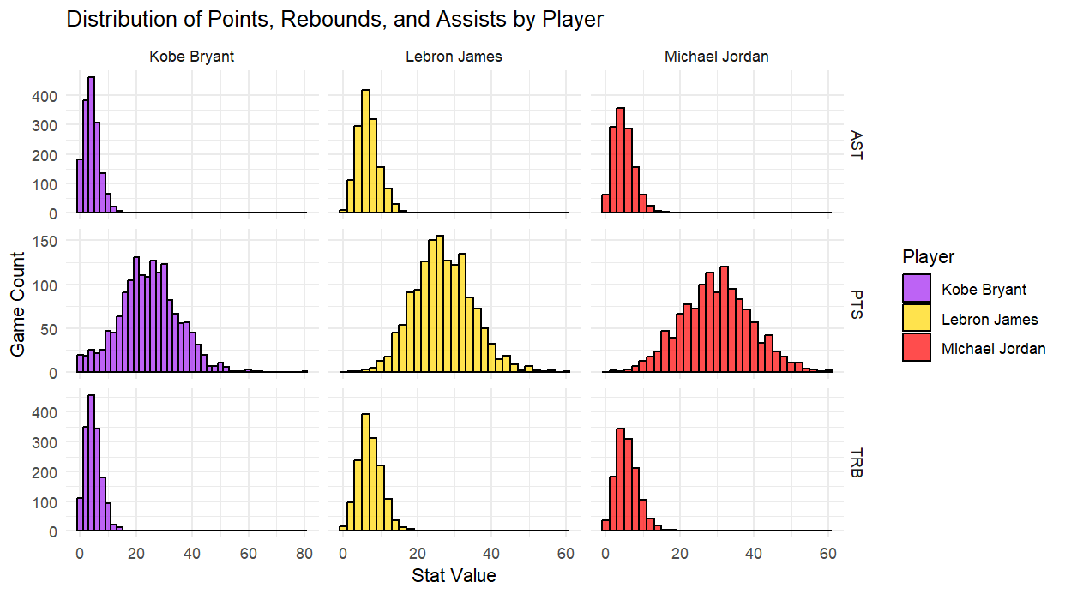
OFFENSIVE IMPACT
Kobe Bryant (Purple Bars) Maintained strong but slightly lower averages in scoring, assists, and rebounds, highlighting his role as a primary scorer with a more focused contribution profile. | LeBron James (Yellow Bars) Demonstrated the most well-rounded impact, leading in both assists and rebounds, reflecting his versatility and all-around contribution to team play. | Michael Jordan (Red Bars ) Led in scoring with the highest median points per game, showcasing his dominant offensive role across a wide range of high-scoring performances.
Notes:
This slide focuses on each player's offensive impact, visualized by the distribution of their points, assists, and rebounds per game across their careers.
You can see Jordan's red bars are centered higher than the others, showing he consistently scored more points per game, his offensive scoring was elite and consistent.
Assists (top row) tell another story. LeBron’s yellow bars are noticeably further right. Meaning he has the highest assist counts overall. He plays more like a point-forward, contributing to team offense through passing.
And in Rebounds (bottom row), again LeBron leads with higher values. His size and playing style have allowed him to be more effective on the boards than Kobe or MJ.
This slide highlights how each player impacted the game differently on offense.
Jordan as the dominant scorer,
LeBron as the all-around playmaker and rebounder,
and Kobe somewhere in between with scoring efficiency and versatility.

Slide 8
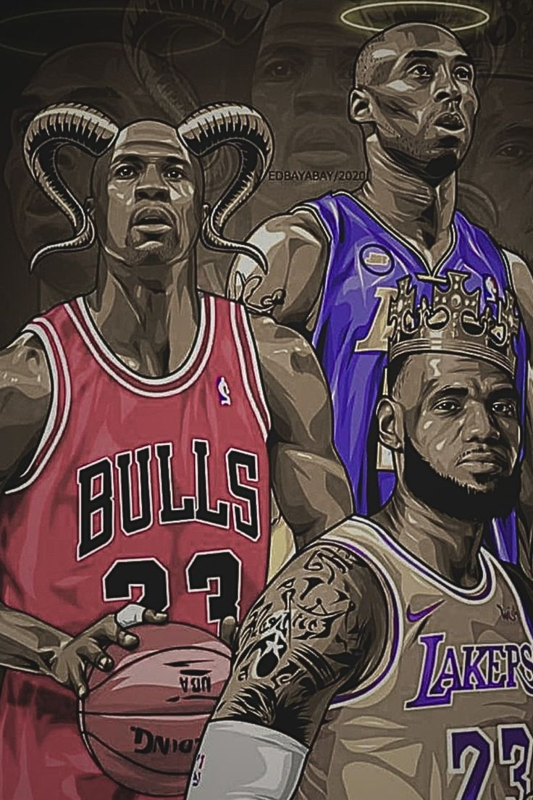
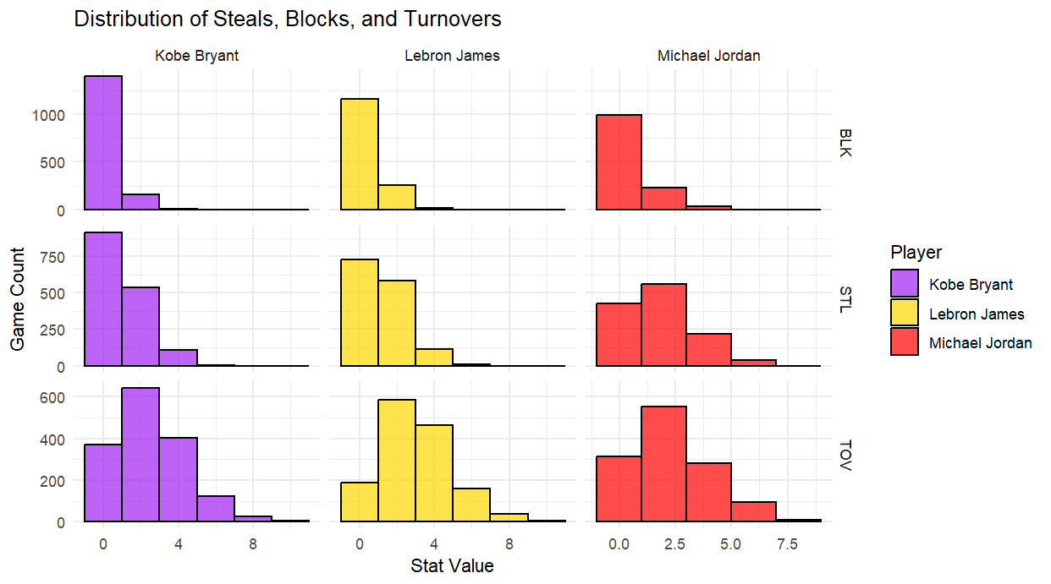
DEFFENSIVE IMPACT
Kobe Bryant (Purple Bars) Contributed consistently on defense with moderate steals and blocks, while maintaining a controlled turnover rate compared to LeBron. | LeBron James (Yellow Bars) Showed balanced defensive stats with solid steal and block numbers but had the highest turnover rate due to his high playmaking role. | Michael Jordan (Red Bars) Led in steals and had low turnovers, highlighting his defensive sharpness and ball control
Notes:
Here I’m comparing the defensive impact of the players using distributions of steals, blocks, and turnovers.
Blocks: All three have most games with 0–1 blocks, but LeBron shows a slightly higher frequency of games with multiple blocks, reflecting his size and versatility.
Steals: Jordan dominates with more high-steal games, reinforcing his elite defensive reputation. Kobe and LeBron show similar, balanced steal patterns.
Turnovers: LeBron has more high-turnover games due to his playmaking role. Kobe and Jordan have fewer turnovers on average, aligning with their scoring focus.
Overall, Jordan stands out for defensive disruption, LeBron for versatility and volume, and Kobe for consistency and balance on both ends.

Slide 9
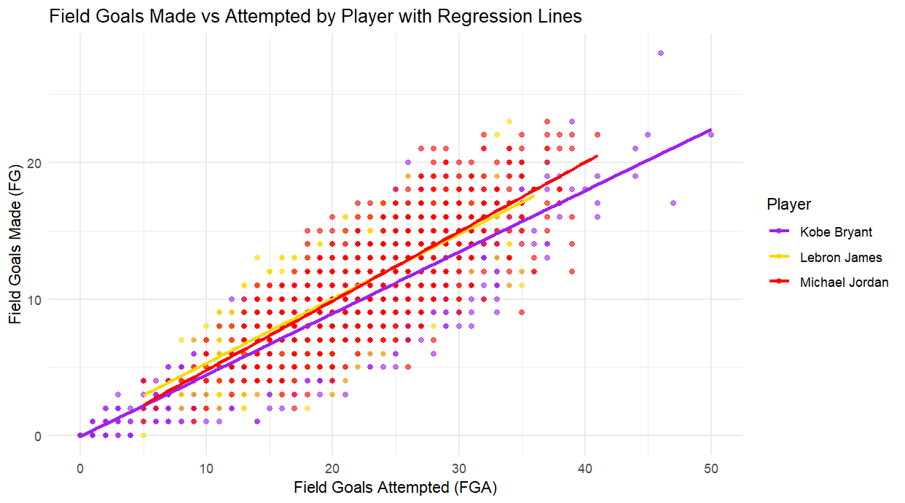
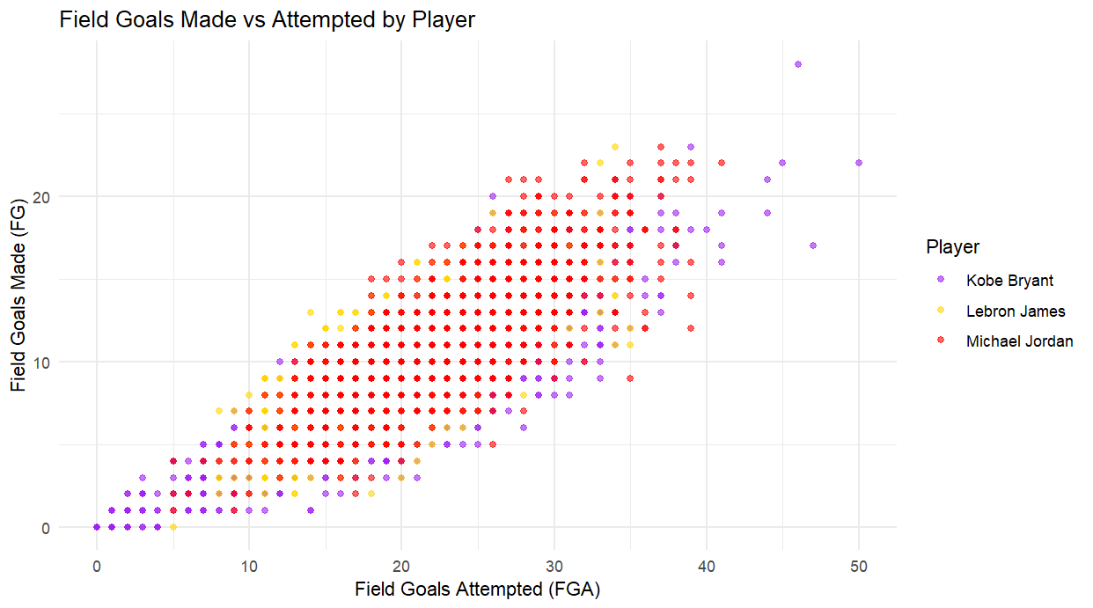
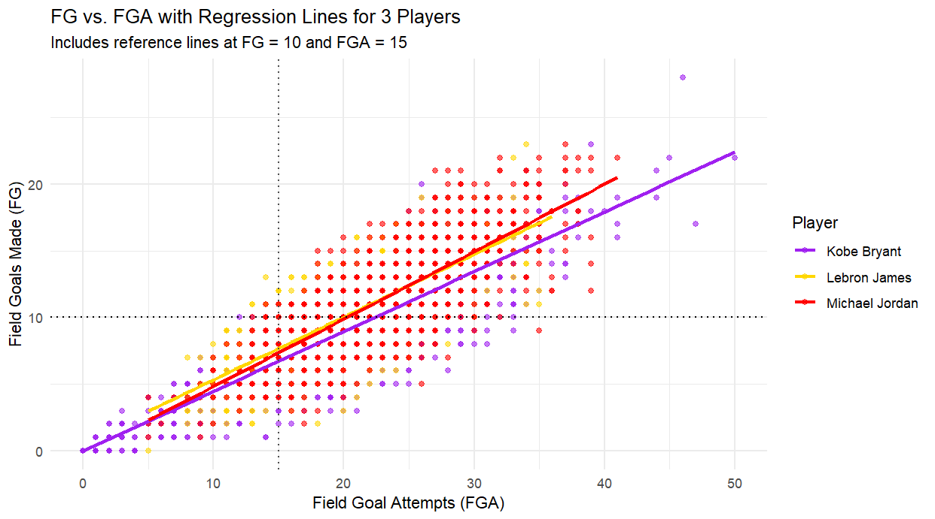
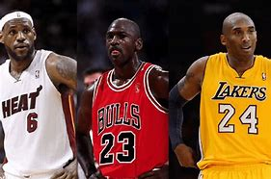
Field goals (FG)
The regression line on this scatter represents the relationship between how many shots each player attempts and how many they make. The horizontal reference line marks the level where a player scores 10 field goals in a game. The vertical reference line marks where a player attempts 15 field goals in a game.
Kobe Bryant (Purple Dots/Line) Kobe’s regression line has a positive slope but slightly less steep than Jordan’s and LeBron’s, suggesting solid but comparatively lower shooting efficiency, especially as attempts increase | LeBron James (Yellow Dots/Line) LeBron’s regression line shows the steepest slope among the three, indicating his high scoring efficiency even at higher volumes of shot attempts, emphasizing his ability to maintain efficiency as usage increases. | Michael Jordan (Red Dots/Line) Jordan’s regression line has a strong positive slope, reflecting his consistent ability to convert a high proportion of shot attempts into made field goals, demonstrating efficient scoring regardless of volume.
Notes:
This slide analyzes the relationship between Field Goals Made (FG) and Field Goal Attempts (FGA) . Each player’s data points and regression lines show how efficiently they convert shot attempts into made baskets.
Kobe Bryant tends to take more shots per game, as indicated by data points extending further right, but his conversion rate is slightly lower compared to the others.
Michael Jordan shows a strong positive correlation with a higher field goal conversion efficiency than Kobe, with many games around 15–30 attempts and solid scoring outputs.
LeBron James demonstrates a balanced efficiency and volume, with regression closely following Jordan’s line but with fewer high-volume shooting games.
Overall, this slide highlights differences in shooting volume and efficiency among the three legends, with Kobe taking more shots, Jordan being highly efficient, and LeBron balancing both.

Slide 10
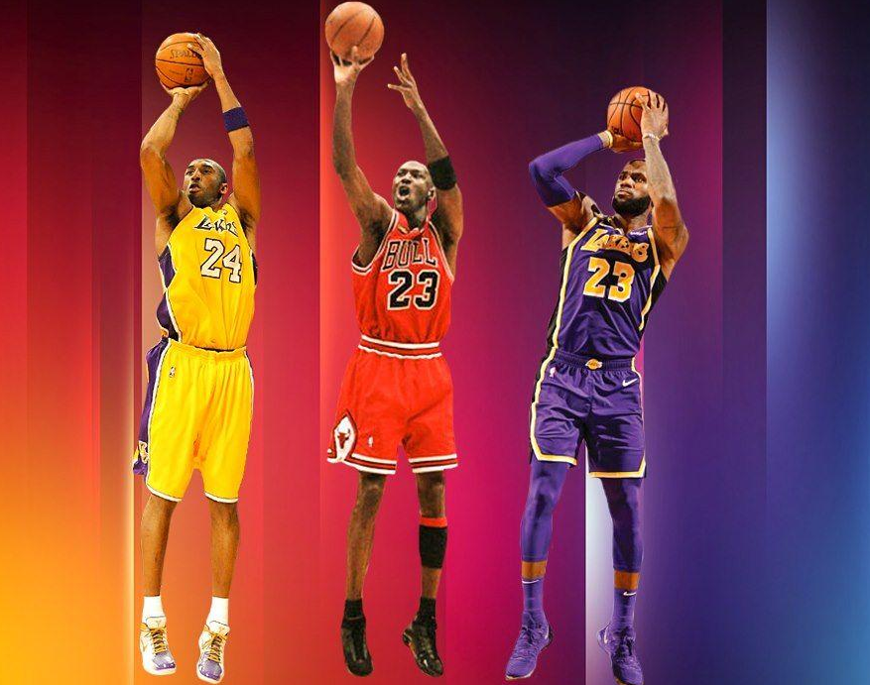
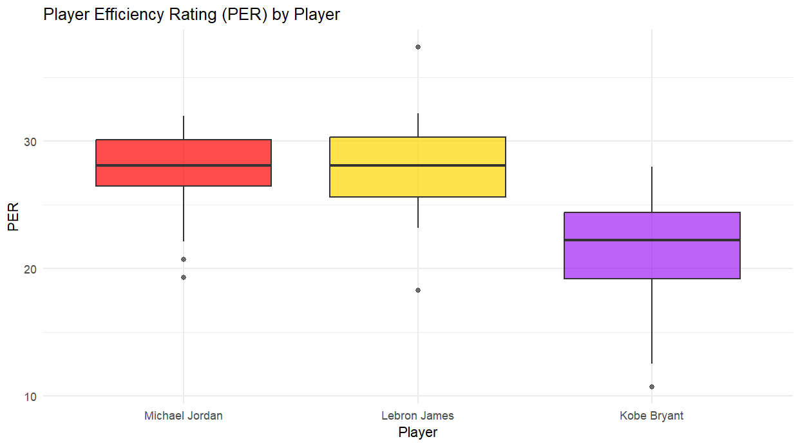
Player Efficiency Rating (PER)
Is a single-number statistic that summarizes the player's overall per-minute performance. It accounts for both positive contributions (like points, assists, rebounds, steals, and blocks) and negative ones (like missed shots and turnovers), and is adjusted for game pace. A PER of 15 is the NBA league average. Higher values indicate greater efficiency and overall impact.
Kobe Bryant (Purple Box) Kobe Bryant’s PER is noticeably lower on average, with a median closer to 23–24 and a wider range extending to some low values, indicating more variability and generally less efficiency compared to the other two legends. | LeBron James (Yellow Box) LeBron’s PER has a slightly wider spread with some higher outliers; suggesting occasional peak performances above Jordan’s range | Michael Jordan (Red Box) Michael Jordan and LeBron James have very similar median Player Efficiency Ratings (PER), both hovering around 28–29, indicating consistently high performance levels
Notes:
This compares the Player Efficiency Rating (PER)
LeBron James and Michael Jordan have similar median PER values around 28-29, indicating consistently high overall efficiency.
Kobe Bryant shows a lower median PER, around 23, with a wider range, suggesting more variability in his performance.
Both LeBron and Jordan have tighter PER distributions, reflecting steadier efficiency across games.
Overall, LeBron and Jordan demonstrate higher and more consistent efficiency compared to Kobe.

Slide 11
TEAM IMPACT
WIN SHARES (WS)
USAGE RATE (USG)
TRUE SHOOTING PERCENTAGE (TS)
WINS & LOSSES

Slide 12
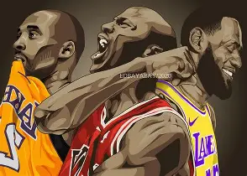
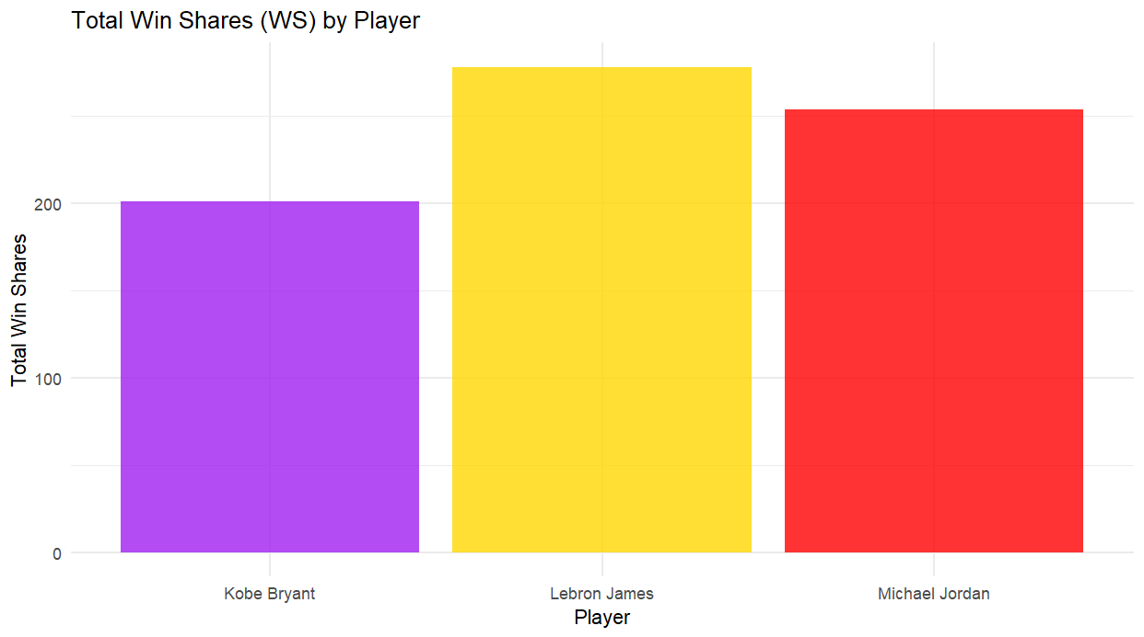
WIN SHARES (WS)
Is an advanced basketball metric that estimates how many wins a player contributed to their team over a career. It breaks down the player’s overall impact into offensive and defensive contributions, combining them into a single number representing total value.
Kobe Bryant (Purple Bar) While a dominant player, Kobe has a lower total WS, which can be attributed to both a shorter peak and the natural effects of injuries and team dynamics over his career. | LeBron James (Yellow Bar) Higher total WS reflects both his sustained elite performance and his longer career span—playing more seasons and minutes compared to Jordan and Kobe. | Michael Jordan (Red Bar) Despite playing fewer seasons (including a couple of retirements), still ranks second, demonstrating exceptional impact during his peak years.
Notes:
This slide compares the Total Win Shares (WS) of each player
LeBron James leads with the highest total win shares, reflecting his significant overall contribution to team victories.
Michael Jordan follows closely behind, demonstrating his strong impact on winning throughout his career.
Kobe Bryant, while still impressive, has the lowest total win shares among the three, indicating comparatively fewer contributions to in assists and rebounds. over his career.
Why It Matters For Comparing Kobe, LeBron, and MJ
When comparing the three players Win Shares help quantify not just how good a player is, but how much their performance translates directly into winning. Making it a valuable metric for GOAT debates.

Slide 13
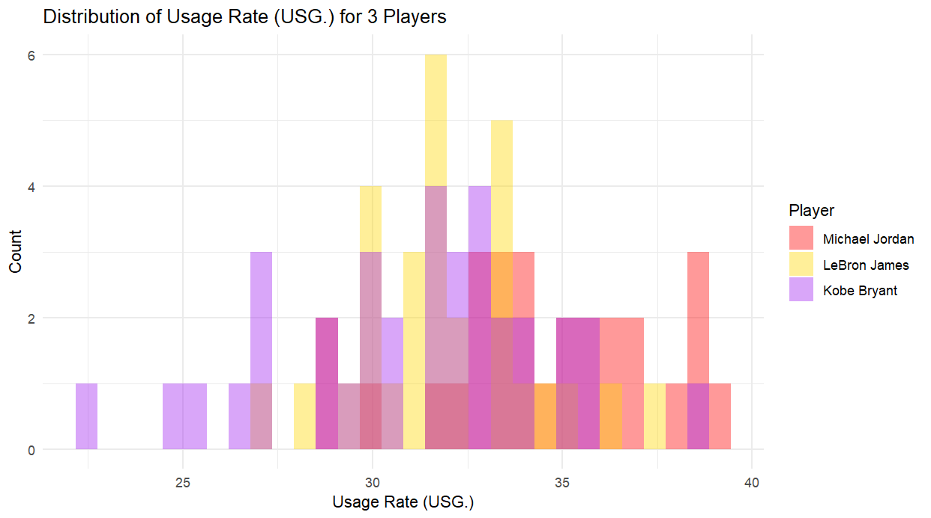
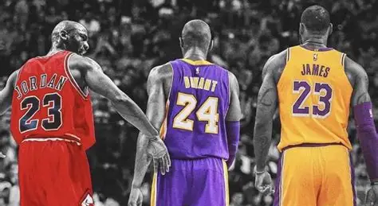
USAGE RATE (USG)
Estimates the percentage of team plays used by a player while they are on the court. It accounts for: Field goal attempts, free-throw attempts and turnovers. Essentially, it measures how involved a player is in their team's offense. A higher USG% means the player is more central to the offense when on the floor.
Kobe Bryant (Purple Bars) Distribution is broad, ranging from low 20s to upper 30s.Indicates variation over his career (early years, peak, post-prime), but with a notable concentration around 30–34% | LeBron James (Yellow Bars) More centered around 30–33%, with fewer outliers at the high end. Suggests he shared the ball more compared to Jordan, reflecting his passing-heavy style. | Michael Jordan (Red Bars) USG% frequently ranges between 30–35%, with some seasons even near 38–39% (very high usage).This reflects his dominant offensive role in most of his career.
Notes:
This illustrates the distribution of Usage Rate (USG) for each player.
Michael Jordan in red shows a higher and more consistent usage rate, often reaching up to 39%, indicating he was frequently involved in offensive plays.
LeBron James has a slightly lower but still significant usage rate, generally clustering around 30-35%, reflecting his pivotal role in team offense.
Kobe Bryant exhibits a wider range of usage rates, including lower values starting near 22%, suggesting more variability in his offensive involvement throughout his career.
Overall, Michael Jordan leads in offensive usage, followed by LeBron James and Kobe Bryant.

Slide 14
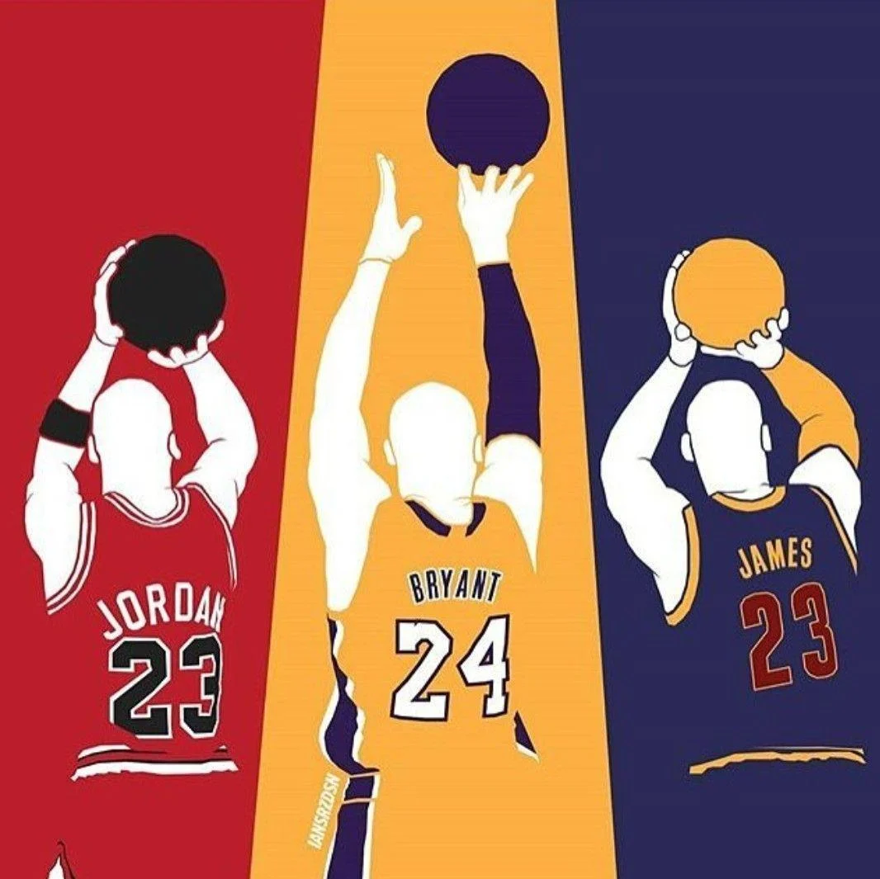
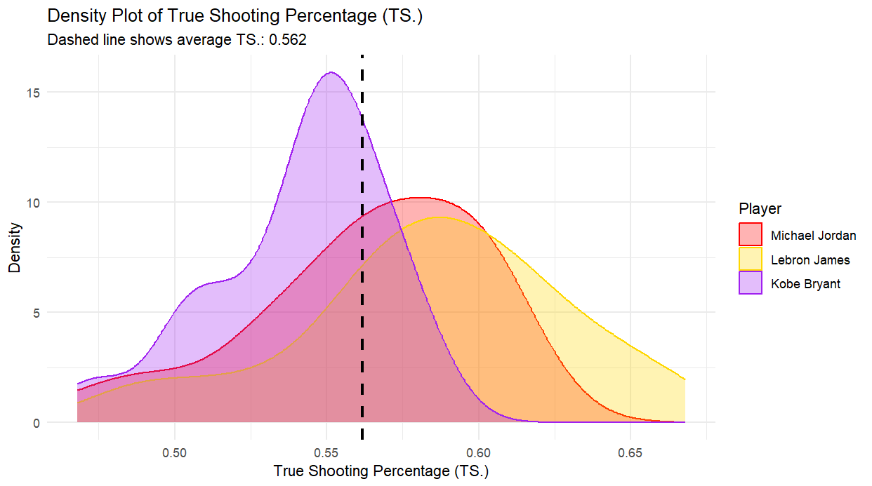
TRUE SHOOTING PERCENTAGE (TS)
True shooting percentage (TS%) is an advanced shooting efficiency metric that accounts for field goals, 3-point field goals, and free throws. It provides a more complete measure of scoring efficiency than traditional field goal percentage.
Kobe Bryant (Purple Curve) TS% distribution is centered left of the average line, peaking around 0.54–0.56.Indicates he was less efficient as a scorer than both LeBron and Jordan. This matches broader analysis that Kobe was a high-volume scorer but not elite in efficiency. | LeBron James (Yellow Curve) Distribution is right-shifted, peaking above the average TS%. He has the highest TS% overall of the three. Indicates very efficient scoring, likely due to shot selection, finishing ability, and free throw frequency.. | Michael Jordan (Red Curve) His peak is around the average line, slightly to the right. Suggests above-average efficiency, especially impressive given his era and volume. More balanced TS% distribution compared to LeBron's skew toward higher efficiency.
Notes:
This is a density plot comparing the True Shooting Percentage (TS%) of the three players. True Shooting Percentage is an advanced efficiency metric that accounts for field goals, three-point shots, and free throws, offering a more comprehensive measure of scoring efficiency than traditional shooting percentages.
Kobe Bryant, represented by the purple curve, shows a peak around the average TS% of 0.562 but demonstrates more variability with a slightly lower overall efficiency.
LeBron James, in yellow, exhibits a broader distribution skewed toward higher TS% values, indicating greater scoring efficiency on average.
Michael Jordan, shown in red, has a consistent and relatively high TS%, with his distribution centered just below LeBron’s but above Kobe’s.
Overall, LeBron James leads in scoring efficiency, followed by Michael Jordan, with Kobe Bryant showing the most fluctuation and slightly lower efficiency in this metric.

Slide 15
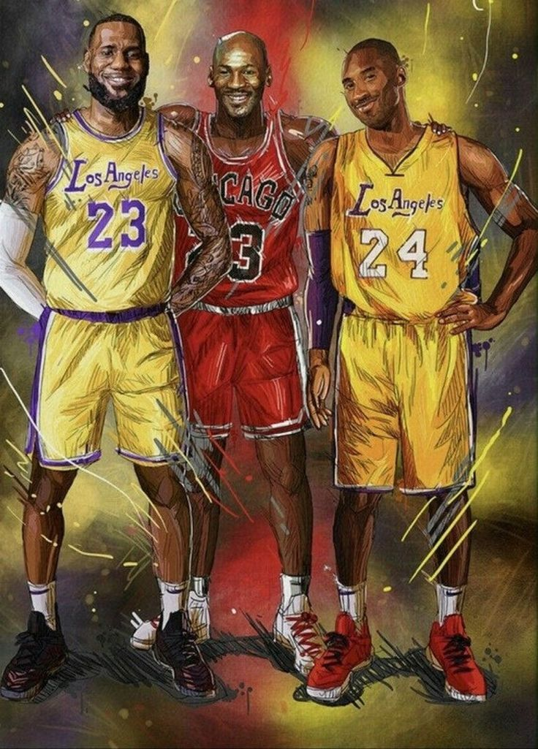
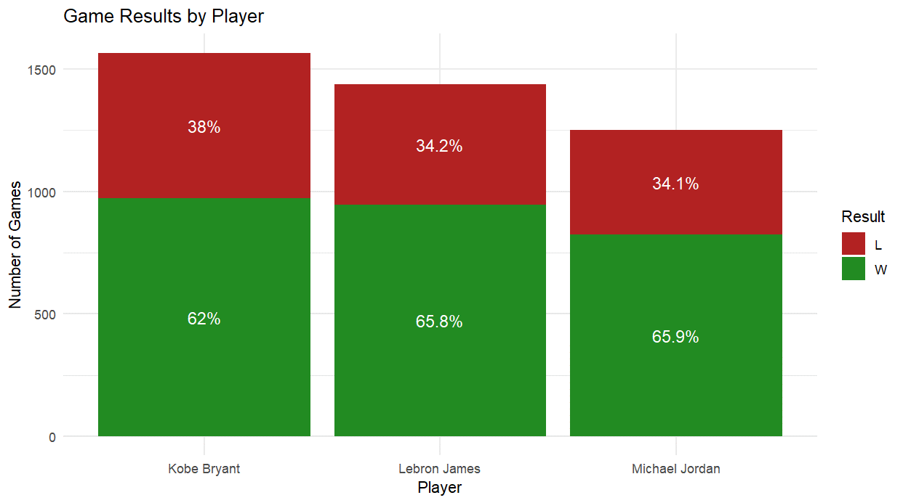
WINS & LOSSES
Each player's bar is divided into two sections:
Green (Wins): Percentage of games won
Red (Losses): Percentage of games lost
Numbers inside the bars show exact percentages
Kobe Bryant This is the lowest win percentage of the three players. Reflects a long career with some rebuilding seasons and late-career struggles (post-Shaq era, injuries). | LeBron James Very high win percentage, slightly below Jordan. Reflects long-term consistency and success, especially during his Miami and Cleveland years. | Michael Jordan The highest win percentage of the three, though just barely above LeBron. Jordan played fewer total games than the other two and had most of his career during the Bulls’ dynasty years.
Notes:
This is a comparison of the winning and losing percentages throughout their careers. Each player's bar is divided into two sections: green representing the percentage of games won, and red representing the percentage of games lost.
Kobe Bryant has a winning percentage of 62% and a losing percentage of 38%.
LeBron James with the highest winning percentage at 65.8%, and a corresponding losing percentage of 34.2%.
Michael Jordan closely follows with a winning percentage of 65.9% and a losing percentage of 34.1%.
Overall, LeBron James and Michael Jordan demonstrate similar, higher winning percentages compared to Kobe Bryant, indicating their teams experienced slightly more success in games during their careers.

Slide 16
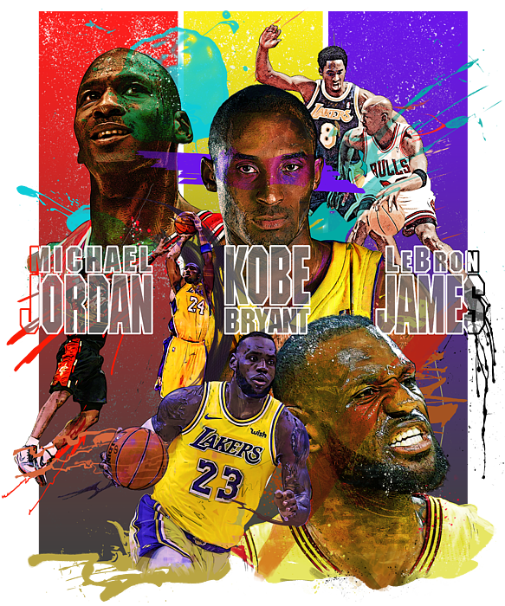

OVERALL ANALYSIS
To evaluate and compare the overall greatness of Michael Jordan, LeBron James, and Kobe Bryant, I considered both individual performance and team contributions using the metrics categorized for player impact [PTS, AST, TRB, BLK, STL, TOV, FG. PER], and team impact [WS, USG, TS, W/L].
Kobe Bryant The Fearless Competitor Usage Rate: Very high with a wide spread, indicating phases of carrying teams alone. True Shooting %: Lowest among the three, suggesting volume over efficiency. Win Percentage: Strong (62%), but slightly behind due to rebuilding years and tough late-career stretches. 5: NBA Championships | LeBron James The Complete All-Around Force Usage Rate: High, but more balanced, showing his role as both scorer and facilitator. True Shooting %: Best among the three, demonstrating elite scoring efficiency. Win Percentage: Nearly identical to Jordan’s (65.8%), showing sustained success across multiple franchises. 4: NBA Championships | Michael Jordan The Relentless Scorer Winner Winner Usage Rate (USG%): Consistently high, reflecting his dominant offensive role. True Shooting % (TS%): Above average, especially impressive given his volume and era. Win Percentage: Highest at 65.9%, with sustained team success during peak years. 6: NBA Championships .
Notes:
This slide provides an overall analysis of the basketball careers of Kobe Bryant, LeBron James, and Michael Jordan, highlighting their unique strengths and playing styles.
Kobe Bryant is described as "The Fearless Competitor," known for his intense work ethic, unyielding determination, and clutch performances that often inspired his team.
LeBron James is labeled "The Complete All-Around Force," emphasizing his versatility on the court, exceptional passing ability, scoring, and leadership that make him a dominant and well-rounded player.
Michael Jordan is called "The Relentless Scorer Winner," reflecting his legendary scoring ability, competitive drive, and six NBA championships that cement his legacy as one of the greatest winners in the sport.
Together, these descriptions capture the distinct qualities that set each player apart and contribute to their status as basketball legends.

Slide 17
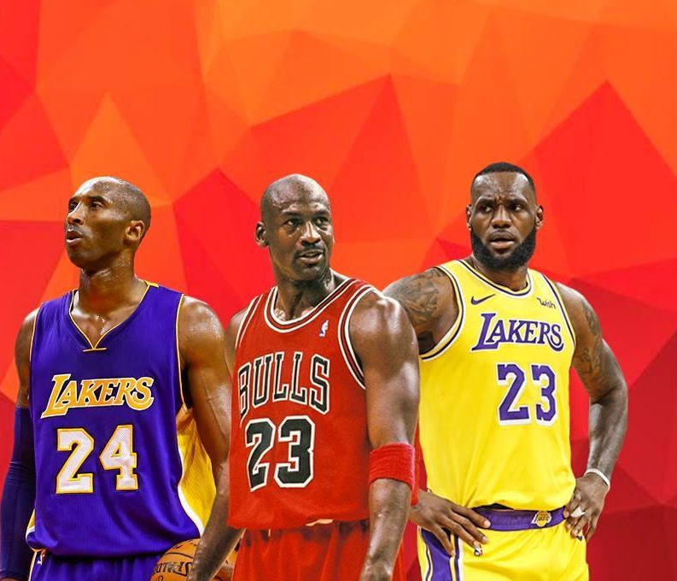

G(Greatest)
O(of)
A(all)
T(time)
Notes:
Based on the data provided, Michael Jordan’s has to be crowned as the GOAT! This title is backed by impressive statistics and achievements. He holds 6 NBA championships with a perfect 6-0 Finals record, demonstrating unmatched success on the biggest stage. His True Shooting Percentage shows high scoring efficiency, and his winning percentage of 65.9% ranks closely with LeBron James, reflecting consistent team success.
In addition to the data evaluated in these slides Jordan also earned 5 MVP awards and was a 10-time scoring champion, proving his dominance as a scorer. His combination of elite scoring efficiency, championship wins, and clutch performance solidifies his legacy as the greatest player in NBA history.

Slide 18


GOAT

